Slide 1
You can use slides from this power point for your meetings with parents, students, and educators and school board members to talk about college and career planning.

Slide 2
Why is it important to do your best on the ACT® test?

Slide 3
Why is it important to do your best on the ACT® test?
It can help students get into college (88% of US colleges consider test scores in admissions decisions)
It gives students information on careers they might enjoy
Scores can lead to scholarship and financial aid opportunities.

Slide 4
Is retesting worth it?

Slide 5
Is retesting worth it?

Slide 7
ACT College Readiness Benchmarks
61% of 2016 ACT-tested high school graduates met the ACT English benchmark

Slide 8
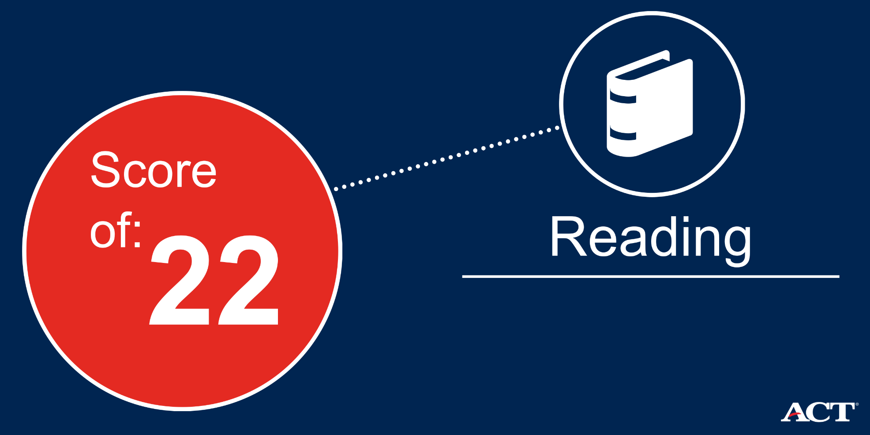
ACT College Readiness Benchmarks
44% of 2016 ACT-tested high school graduates met the ACT reading benchmark

Slide 9
ACT College Readiness Benchmarks
41% of 2016 ACT-tested high school graduates met the ACT mathematics benchmark

Slide 10
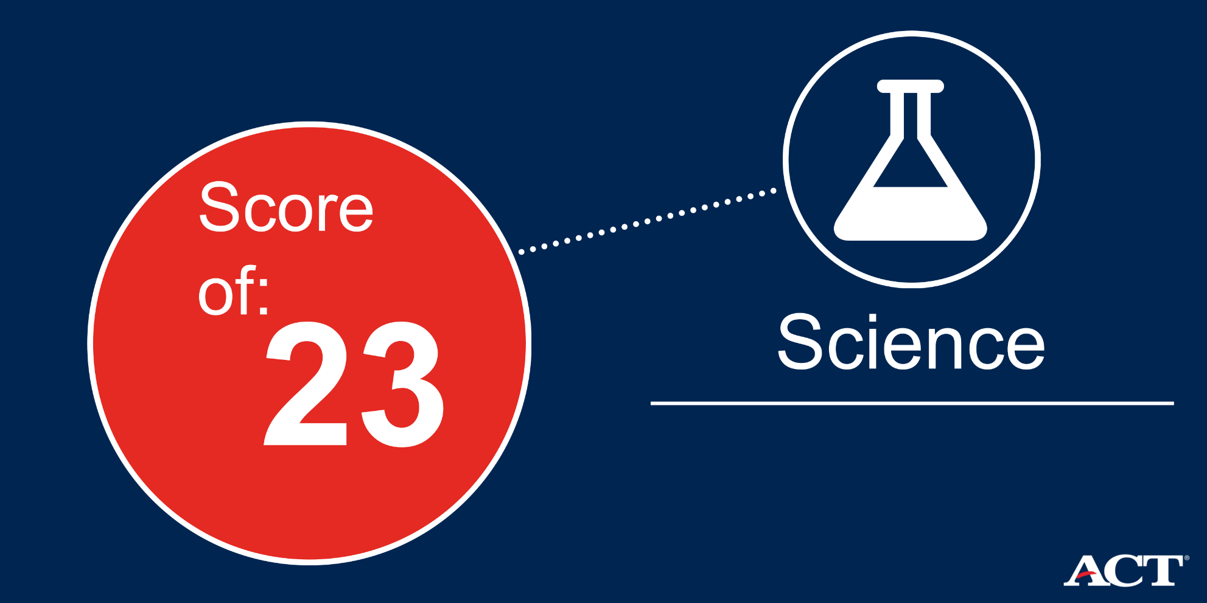
ACT College Readiness Benchmarks
36% of 2016 ACT-tested high school graduates met the ACT science benchmark

Slide 18
